Slide 1

European University of Lefke
Department of Computer Engineering
Graduation Project Presentation
2019-2020 Spring
Image Steganography
Emmanuel Maneswa (154409)
Advisor : Assist. Prof. Dr. Cem B. Kalyoncu

Slide 2
Outline
Introduction
Previous Implementation
Project Plan/Problem Definition
Technology Used
Work Done
Difficulties Faced
Conclusions
What I Learnt
Demonstration
Image Steganography

Slide 3
Introduction
Steganography is the art of concealing information within other non-secret data.
With increase in computational power everyday I think encryption is becoming obsolete and attacks on encrypted data have increased.
Even with the rise in computational power if we turn to steganography the attacks might be minimized because the attacker might no be able to distinguish between a normal image and an image containing sensitive data.
Sensitive data might be system passwords or keys, etc.
Image Steganography

Slide 4


Previous Implementation
The basic method of LSB is bit substition on the LSB of the color matrices.
For instance these bits (110100010) of sensitive data need to be embedded.
The data will be simply substituted into every LSB matrix, however this is not secure.
Image Steganography

Slide 5
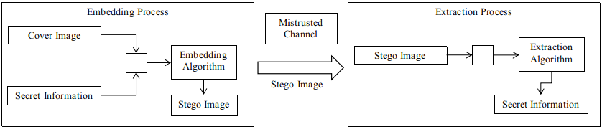
Previous Implementation (Cont.)
Image Steganography

Slide 6
Project Plan/Problem Definition
Since the technique shown on the previous slide is not secure.
For my project I planned to implement a way to securely embed the sensitive messages/text into images.
According to this target I managed to accomplish my main goal.
Image Steganography

Slide 7
Technology Used
Platform used
Linux.
Programming languages, scripts used
C++, QML, JavaScript.
QML is a user interface markup language. (Qt Modeling Language).
Inline JavaScript handles Imperative aspects in QML.
QML and JavaScript code can be compiled to native C++ binaries with the Qt Quick compiler. This makes the application fast.
Image Steganography

Slide 8
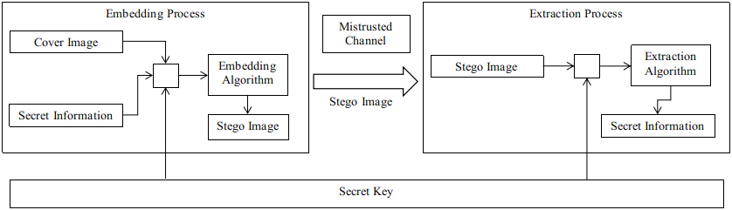
Work Done
Since I mentioned before that the I wanted to implement a secure LSB technique, I accomplished that by introducing a key into the equation.
Image Steganography

Slide 9
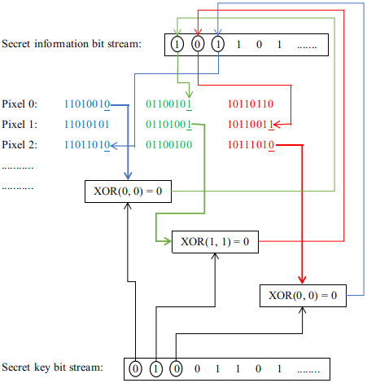
Work Done (Cont.)
By doing so the embedding technique follows these rules.
Image Steganography

Slide 10
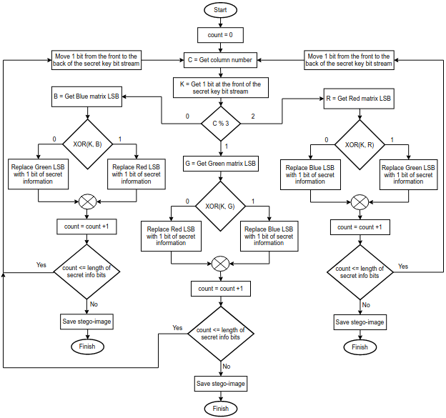
Work Done (Cont.) embedding
Image Steganography

Slide 11
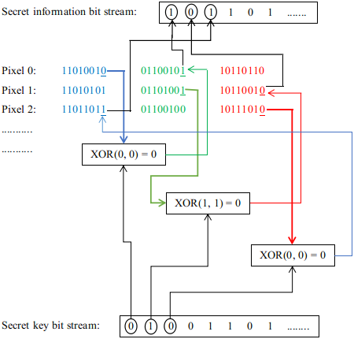
Work Done (Cont.)
For the extraction technique the reverse of the embedding process is needed.
Image Steganography

Slide 12
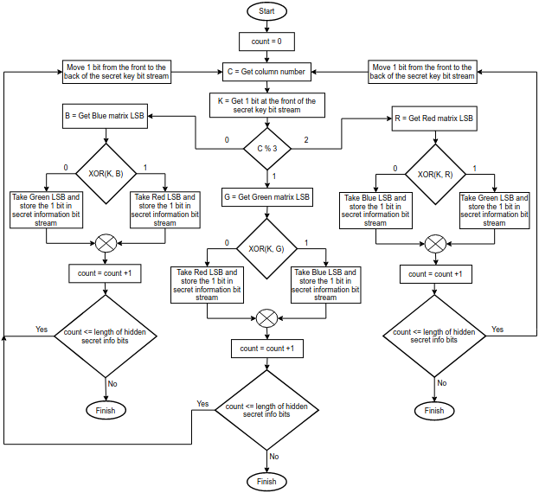
Work Done (Cont.) Extraction
Image Steganography

Slide 13
Difficulties Faced
The main difiiculty I faced was when trying to save the changes done to the cover image in jpeg format.
The changes did not take effect, and after adequate research I found out that some image formarts use lossy compression algorithms and jpeg is one of those image formats.
Inorder to counter this I then chose to save the changes in png formart because it uses a loss-less compression algorithm.
Image Steganography

Slide 14
Conclusions
I managed to complete the task of securely hiding sensitive text information inside images and created the desktop application.
I archieved the promises I gave in COMP400 (Graduation Project 1).
Image Steganography

Slide 15
What I Learnt
basic understanding on how image manipulation works.
Qt and C++ integration. Since C++ does not have its own inbuilt GUI creation libraries.
Image Steganography

Slide 16
Demonstration
Application Demonstration.
Image Steganography

Slide 17
THANK YOU
Image Steganography

